Slide 1
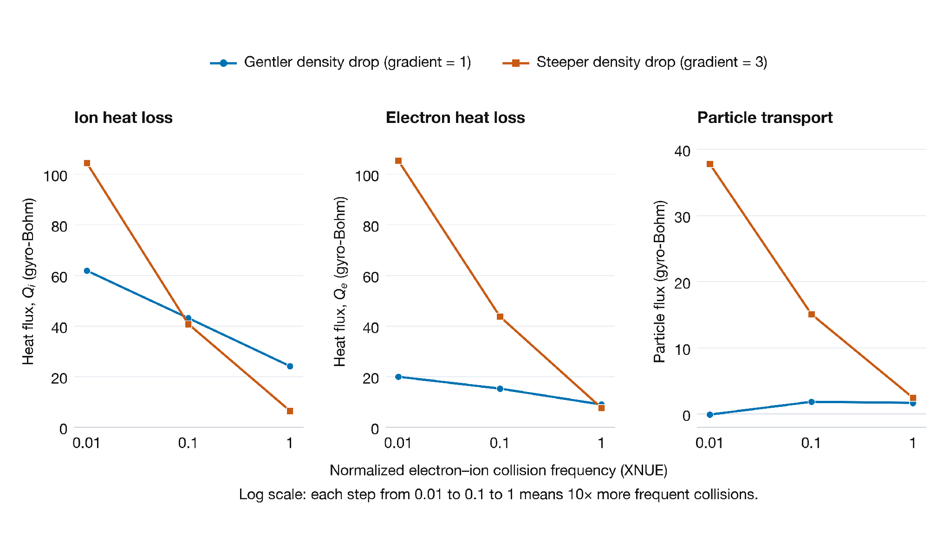
How collision frequency changes plasma transport
Notes:
Collision frequency changes how density gradients affect transport. Each horizontal axis shows normalized electron–ion collision frequency (XNUE) on a logarithmic scale: 0.01, 0.1, and 1 are successive tenfold increases. The vertical axes show ion heat flux (Q_i), electron heat flux (Q_e), and particle flux (Gamma_e = Gamma_i), each in its corresponding gyro-Bohm units. Blue circles represent a gentler shared electron–ion density gradient of 1; orange squares represent a steeper gradient of 3 (RLNS_1 = RLNS_2). A steeper gradient means a sharper local fractional decrease in density toward the plasma edge, not a higher density at the modeled location. All six cases use deuterium, with the other retained physical inputs fixed. At low collision frequency, the steeper density drop raises both heat fluxes; at high collision frequency, it lowers them. Electron particle flux remains higher for the steeper gradient, but the gap narrows. For Project A1, this shows why density gradients and collisions should be considered together when explaining or predicting transport. Lines connect simulation outputs; they are not fitted curves. The particle-flux panel uses a different vertical scale.
Source: six matched deuterium cases j_D, a_D, k_D, x_D, f_D, and z_D from assignments/A1/datasets/SAT3_dataset_v1/SAT3_dataset/data. The graph values were checked against input.tglf.gen and out.tglf.gbflux in each case's tglf_sat2 directory. The original plot was regenerated from the same simulation values with consistent typography. The data, axes, labels, and series colors are retained. Units are gyro-Bohm units. These are local transport predictions, not total reactor heat loss.
The third panel is titled Particle transport because the electron and ion particle fluxes are identical in all 43 supplied cases. Each curve represents both species at the indicated density gradient.

Slide 2
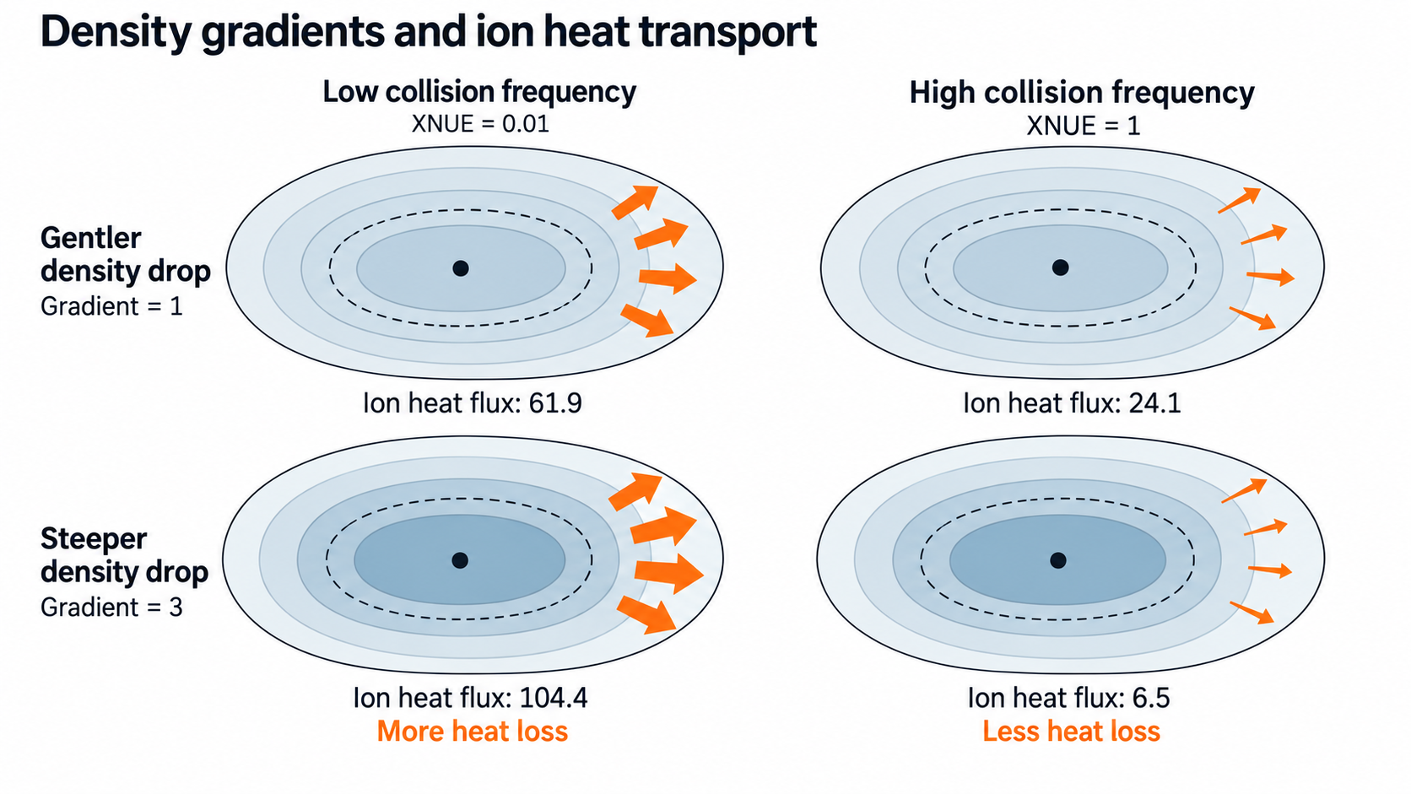
Density gradients and ion heat transport
Low collision frequency
High collision frequency
XNUE = 0.01
XNUE = 1
Gentler
density drop
Gradient = 1
Ion heat flux: 61.9
Ion heat flux: 24.1
Steeper
density drop
Gradient = 3
Ion heat flux: 104.4
Ion heat flux: 6.5
More heat loss
Less heat loss
A steeper density drop raises ion heat loss when collisions are rare,
but lowers it when collisions are frequent.
This shows why we need to study density gradients and collisions together to understand heat loss.
Notes:
The graphic is schematic. Its density shading and arrow widths are qualitative, not measured spatial profiles or calibrated scales. The two takeaway sentences refer to these matched deuterium simulations. The original generated artwork is embedded without image edits, with an editable caption added below it.
Suggested explanation, about 45 seconds:
Ion heat flux is like a reading on a heat-flow meter. It tells us how much energy the ions carry outward across a plasma surface per unit area and time. When that reading rises, more heat leaves the region inside that surface. When it falls, less heat leaves that region.
We compared the same density-gradient change at two collision frequencies. At low collision frequency, steepening the density gradient raises the ion heat flux from 61.9 to 104.4. At high collision frequency, the same gradient change lowers it from 24.1 to 6.5.
Why can the response change? Density gradients can drive turbulent motion, and collisions can alter the plasma response and the turbulence that transports energy. This is physical context for a possible explanation. The input and flux files alone do not identify the specific instability or mechanism that creates the reversal. Do not claim that collisions always suppress turbulence or always improve confinement.
For Project 1A, the result tells us why we should compare matched cases and consider inputs together. A single overall correlation can miss this change in direction. In later surrogate-model work, this comparison is a useful check of whether the model captures the combined effect of density gradient and collision frequency.
Scope and units:
These are local TGLF/SAT2 predictions for deuterium, not a measurement of total reactor heat loss. Flux units are gyro-Bohm units. Both electron and ion density gradients change together: RLNS_1 = RLNS_2. XNUE is normalized electron-ion collision frequency. All other retained physical inputs are fixed. Lower local ion heat flux alone does not establish a globally optimal operating state or fusion performance.
Data provenance:
j_D: XNUE 0.01, gradient 1, Q_i 61.859
x_D: XNUE 0.01, gradient 3, Q_i 104.430
k_D: XNUE 1, gradient 1, Q_i 24.138
z_D: XNUE 1, gradient 3, Q_i 6.4899
Original files: assignments/A1/datasets/SAT3_dataset_v1/SAT3_dataset/data/<case>/tglf_sat2/input.tglf.gen and out.tglf.gbflux. Species 2 is deuterium. Q_i is the fourth entry in the two-species gbflux file.
Primary references for physical context and variable definitions, accessed 2026-10-16:
https://gafusion.github.io/doc/tglf.html
https://gafusion.github.io/doc/tglf/tglf_list.html#xnue
https://gafusion.github.io/doc/tglf/tglf_list.html#xnu-factor
https://gafusion.github.io/doc/tglf/tglf_list.html#rlns-1
https://arxiv.org/abs/1112.0636
The Skyman, Nordman, and Strand study supplies an example of density-gradient-driven turbulence, not a mode identification or validation for these four cases.

